Slide 1

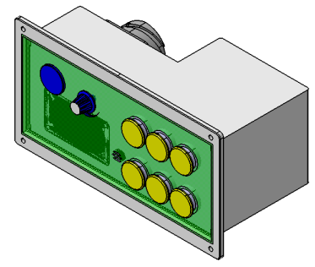
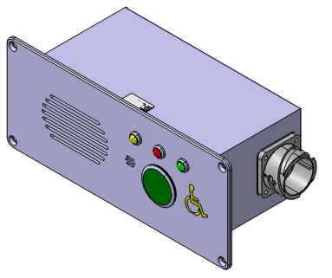


VOIP – InterCom Communication.
OCC
~~(voip Data) | UNIT CODE
~~(voip Data) | UNIT CODE
DPO CODE
PEI CODE
PEI
DPO

Slide 2
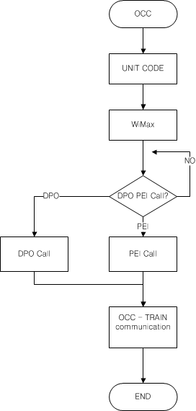
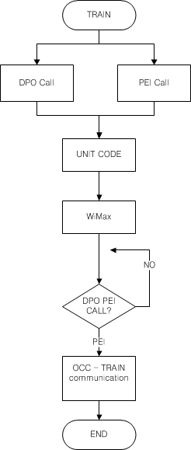
OCC -> TRAIN Communication
Flowchart
TRAIN -> OCC Communication
Flowchart

